Slide 1
MINOR PROPHETS 2
Obadiah, Jonah, Micah, Nahum, Habakkuk, Zephaniah

Slide 2
MINOR PROPHETS 2
Obadiah ~ "Servant of Jehovah"
Obadiah, Jonah, Micah, Nahum, Habakkuk, Zephaniah

Slide 3
MINOR PROPHETS 2
Obadiah (Edom) 586 BC *
North
825 BC
725 BC
625 BC
525 BC
South
* Date approx
Obadiah, Jonah, Micah, Nahum, Habakkuk, Zephaniah

Slide 4
MINOR PROPHETS 2
Galatians 5.17 ~ For the flesh lusts against the Spirit, and the Spirit against the flesh; and these are contrary to one
Another, so that you do
not do the things that you
wish.
Obadiah, Jonah, Micah, Nahum, Habakkuk, Zephaniah

Slide 5
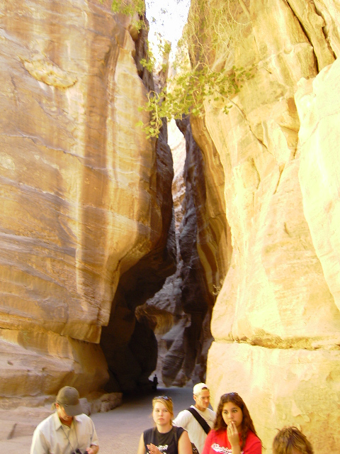
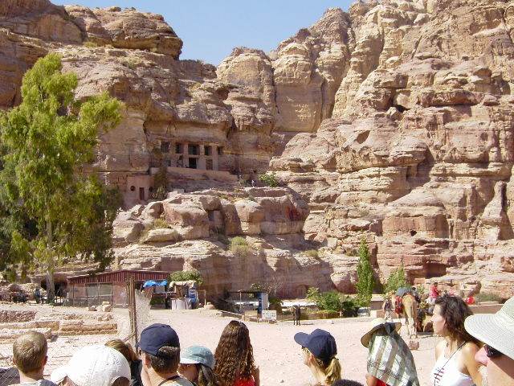
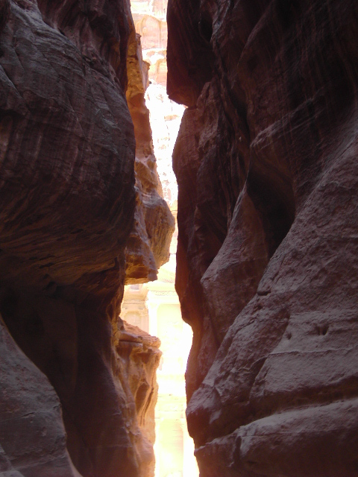
MINOR PROPHETS 2
Obadiah, Jonah, Micah, Nahum, Habakkuk, Zephaniah

Slide 6
MINOR PROPHETS 2
Eph 6:12 ~ For we do not wrestle against flesh and blood, but against principalities, against powers, against the rulers
of the darkness of this
age, against spiritual hosts
of wickedness in the
heavenly places.
Obadiah, Jonah, Micah, Nahum, Habakkuk, Zephaniah

Slide 7
MINOR PROPHETS 2
Jonah ~ "Dove"
Obadiah, Jonah, Micah, Nahum, Habakkuk, Zephaniah

Slide 8
MINOR PROPHETS 2
Jonah (Nineveh) 825 BC *
Obadiah (Edom) 586 BC *
North
825 BC
725 BC
625 BC
525 BC
South
* Date approx
Obadiah, Jonah, Micah, Nahum, Habakkuk, Zephaniah

Slide 9
MINOR PROPHETS 2
Micah ~ “Who is like Jehovah?"
Obadiah, Jonah, Micah, Nahum, Habakkuk, Zephaniah

Slide 10
MINOR PROPHETS 2
Jonah (Nineveh) 825 BC *
Obadiah (Edom) 586 BC *
North
825 BC
725 BC
625 BC
525 BC
South
Micah
737-690 BC *
* Date approx
Obadiah, Jonah, Micah, Nahum, Habakkuk, Zephaniah

Slide 11
MINOR PROPHETS 2
Nahum ~ “Comfort"
Capernaum ~ k’far na’um (“village of Nahum”)
Obadiah, Jonah, Micah, Nahum, Habakkuk, Zephaniah

Slide 12
MINOR PROPHETS 2
Jonah (Nineveh) 825 BC *
Nahum (Nineveh) 615 BC *
Obadiah (Edom) 586 BC *
North
825 BC
725 BC
625 BC
525 BC
South
Micah
737-690 BC *
* Date approx
Obadiah, Jonah, Micah, Nahum, Habakkuk, Zephaniah

Slide 13
MINOR PROPHETS 2
Habakkuk ~ "Embrace"
Obadiah, Jonah, Micah, Nahum, Habakkuk, Zephaniah

Slide 14
MINOR PROPHETS 2
Jonah (Nineveh) 825 BC *
Nahum (Nineveh) 615 BC *
Obadiah (Edom) 586 BC *
North
825 BC
725 BC
625 BC
525 BC
South
Habakkuk609 BC *
Micah
737-690 BC *
* Date approx
Obadiah, Jonah, Micah, Nahum, Habakkuk, Zephaniah

Slide 15
MINOR PROPHETS 2
Zephaniah= “Jehovah Remembers”
Obadiah, Jonah, Micah, Nahum, Habakkuk, Zephaniah

Slide 16
MINOR PROPHETS 2
Jonah (Nineveh) 825 BC *
Nahum (Nineveh) 615 BC *
Obadiah (Edom) 586 BC *
North
825 BC
725 BC
625 BC
525 BC
South
Habakkuk609 BC *
Micah
737-690 BC *
Zephaniah
642-611 BC
* Date approx
Obadiah, Jonah, Micah, Nahum, Habakkuk, Zephaniah

Slide 17
MINOR PROPHETS 2
The Crucible – Anonymous
Under the press and the roller,
Into the jaws of the mint,
Stamped with the emblem of
freedom
With never a flaw or a dent.
Oh! what a joy the refining
Out of the damp and the mold!
And stamped with the
glorious image,
Oh, beautiful coin of gold!
Out of the mine and the darkness,
Out of the damp and the mold,
Out from the fiery furnace,
Cometh each grain of gold.
Crushed into atoms and leveled
Down to the humblest dust
With never a heart to pity,
With never a hand to trust.
Molten and hammered and beaten,
Seemeth it ne'er to be done.
Oh! for such fiery trial,
What hath the poor gold done?
Oh! 'twere a mercy to leave it
Down in the damp and the mold.
If this is the glory of living,
Then better to be dross than
gold.
Obadiah, Jonah, Micah, Nahum, Habakkuk, Zephaniah

